Slide 1
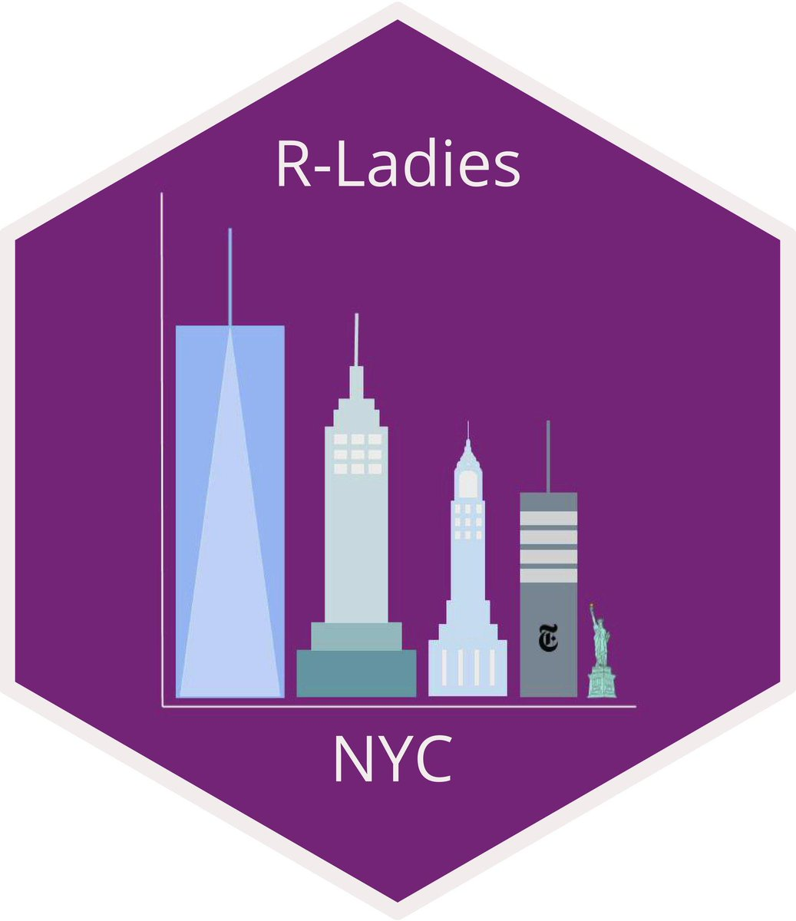


It’s Time to Shine with the timetrackR App
February 26, 2020
Jessica Lavery

Slide 2
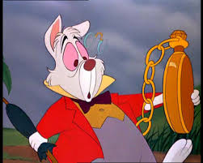

Time & the busy RLady
Often feels like there aren’t enough hours in the day
Start working on one project, check email, bounce to another project, maybe remember to go back to first project, and oh look! It’s 5pm
Long term: you have no recollection of how you’re spending your days
Notes:
Brief note that a lot of what I’m going to talk about has to do with the structure of my job, which is primarily project based across multiple investigators. While that specific scenario won’t hold for everyone here, the general concepts are applicable.

Slide 3
Why use a time tracker summary app?
It’s hard to manage your time if you don’t know how you’re spending your time
Recall is often inaccurate
Feels like we spend a lot of time on projects we don’t love and not enough time on projects we do
Useful for goal-setting and evaluating
Aids in forecasting/resource allocation decisions
Notes:
Sometimes useful for effort certification reports if your organization requires them

Slide 4
Potential tools for tracking & analyzing your time
timetrackR
Other software
Entirely customizable
Free!
e.g. Toggl (free and paid versions), RescueTime, Everhour
Less labor intensive/maintenance not required
Can monitor apps and URLs used and identify distracters (hello Slack!)
More precise: down to the minute (if this is desired)

Slide 5
Motivation for the DIY Shiny App
On a team of 3 statisticians at the time
Overlap in projects and investigators
Track individually or in aggregate
Wanted experience with R & Shiny
Used previous RLadies presentation to get started: Learning Shiny with NBA data
Wanted simple, easily interpretable metrics/visualization – didn’t want to spend all of my time analyzing my time
Project based work:
Principal Investigator / Project

Slide 6
Time tracking metrics & visualizations
Percent effort: Time spent per project/investigator/task
Total hours: Cumulative total number of hours spent on a project
Gantt Chart: Project phase by calendar time

Slide 7
Time tracking metrics: Percent effort
Allocated vs expended effort
Did an investigator ask for “quick help” on a project that is now taking up 30 hours a week?
Task management
As a statistician, what percentage of time is spent in meetings vs doing analyses? Does this need to be rebalanced?
Comparing time invested to products generated
Did an abstract take as long as a full analysis for a manuscript?
For a time-intensive project, was the result multiple manuscripts?
Protecting your time
What percentage of my time am I spending on professional development? Is this more or less than I want it to be?
What percentage of my time am I spending on departmental activities (seminars, interviews, etc.) or other non-project work? Am I appropriately accounting for that when estimating how long it will take me to complete a project?

Slide 8
Time tracking metrics: Total hours
Useful metric for when re-analyses are requested
“We’ve spent 20 hours on the analysis, please circulate the manuscript draft before we complete additional analyses.”
Determining when to cut your losses and when to pursue a project further
“We’ve spent 200+ hours on this project and aren’t close to the deliverable. Is this even going to be feasible?”
“We’ve spent 100 hours on work for this conference presentation, should we turn it into a manuscript?”

Slide 9
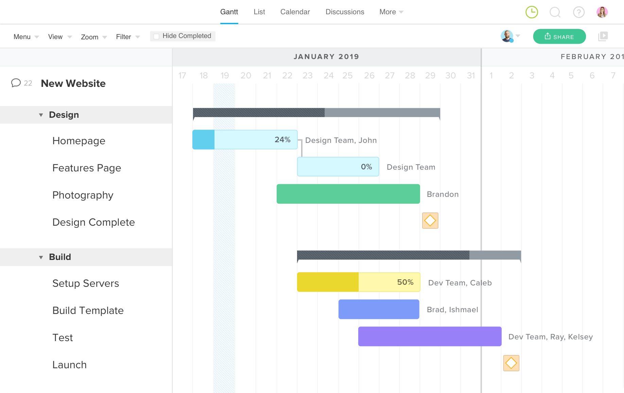
Time tracking viz: Gantt chart
Useful for a big picture overview of what projects are going on & when (and for how long)
Usually used prospectively, but good for a year in review when used retrospectively
Indicates transitions between analysis and re-analysis, indicates if analyses are happening after a manuscript is drafted, etc.
Want to see: Project planning -> Analysis -> Manuscript -> Revisions
Do not want to see: Analysis -> Manuscript -> Re-analysis -> Project Planning -> Analysis -> etc.

Slide 10
timetrackR Data
Started tracking my time in 2017
Previously at a Contract Research Organization where I had to bill my hours to specific projects, so I was used to tracking my time
Reasonably consistent: track 3-5 days/week
Spend <5 minutes a day tracking my time

Slide 11
timetrackR Demo

Slide 12
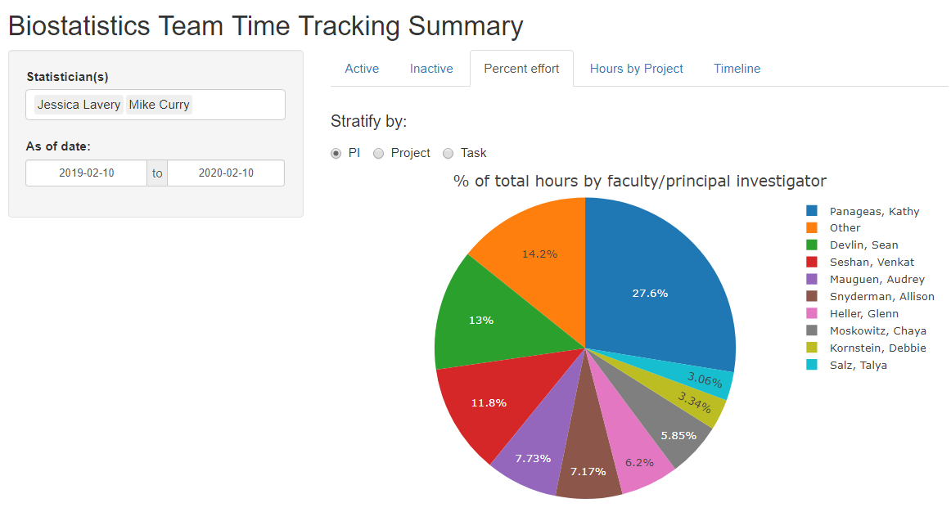
Backup Screenshots

Slide 13
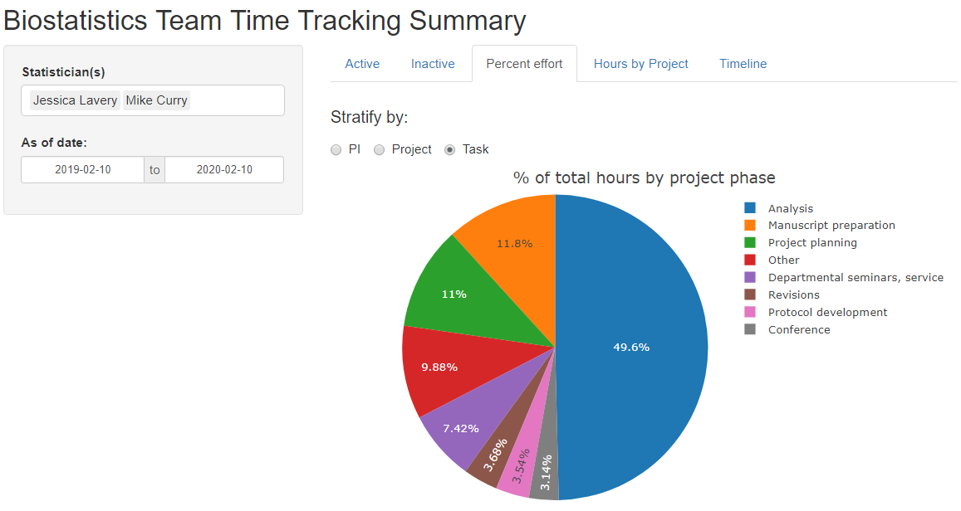
Backup Screenshots

Slide 14
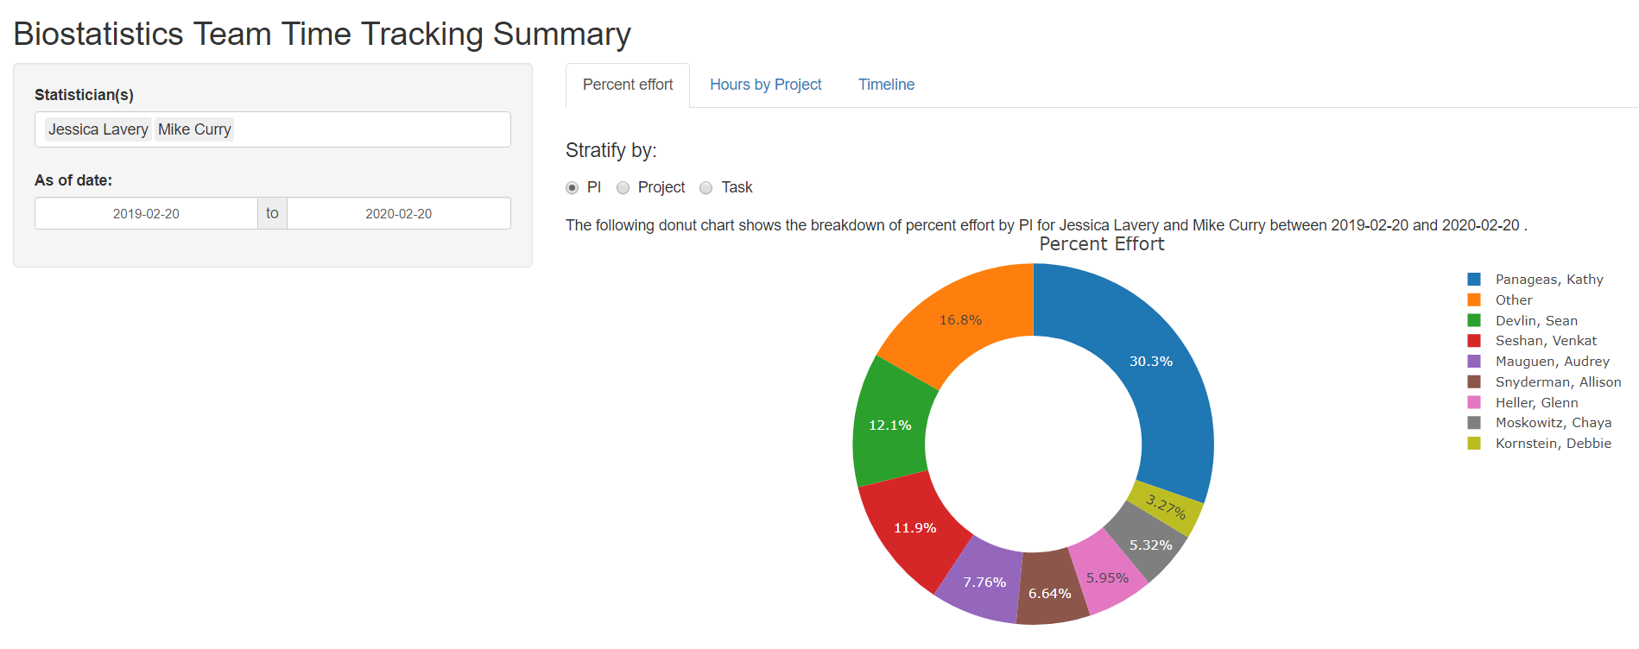

Slide 15
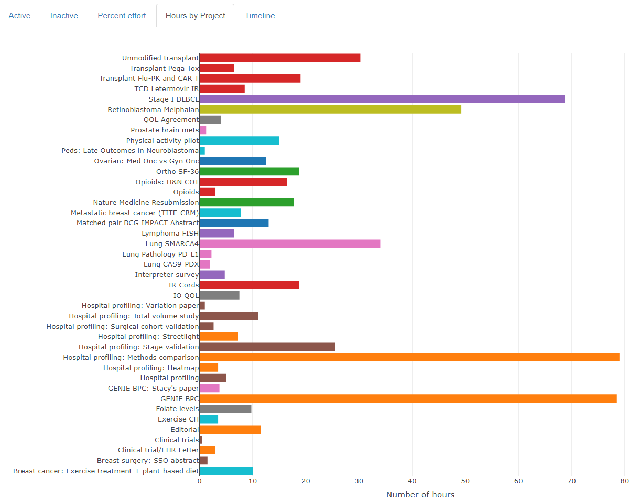
Backup Screenshots

Slide 16
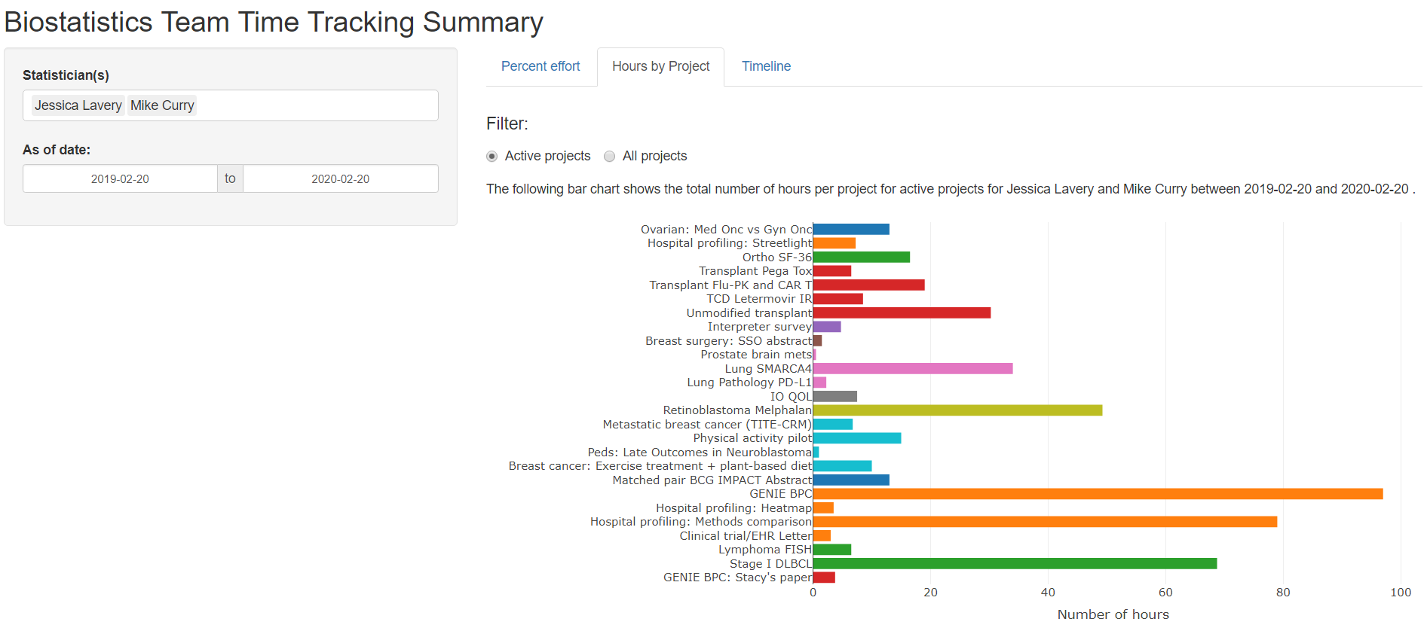

Slide 17
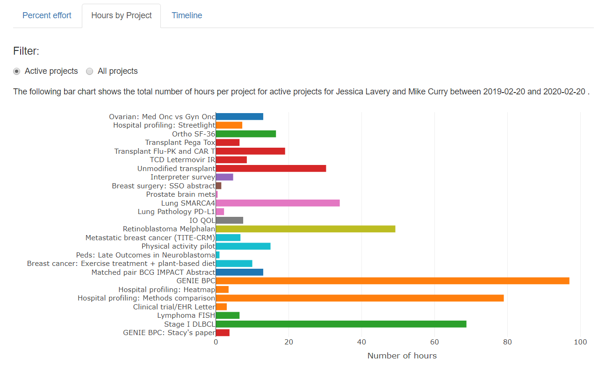

Slide 18
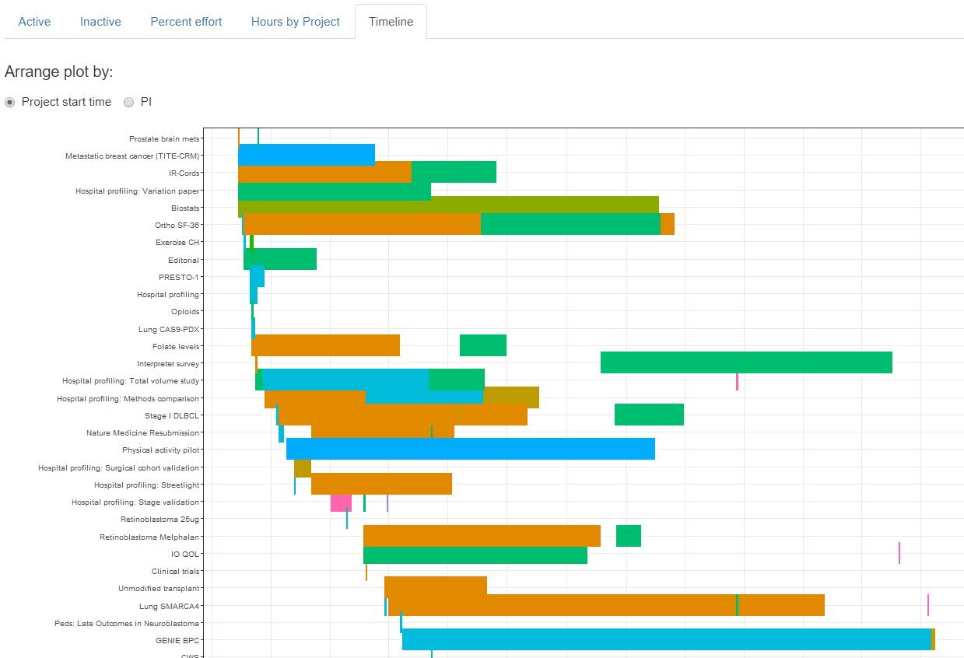
Backup Screenshots
Notes:
Will be cleaned up before presentation

Slide 19
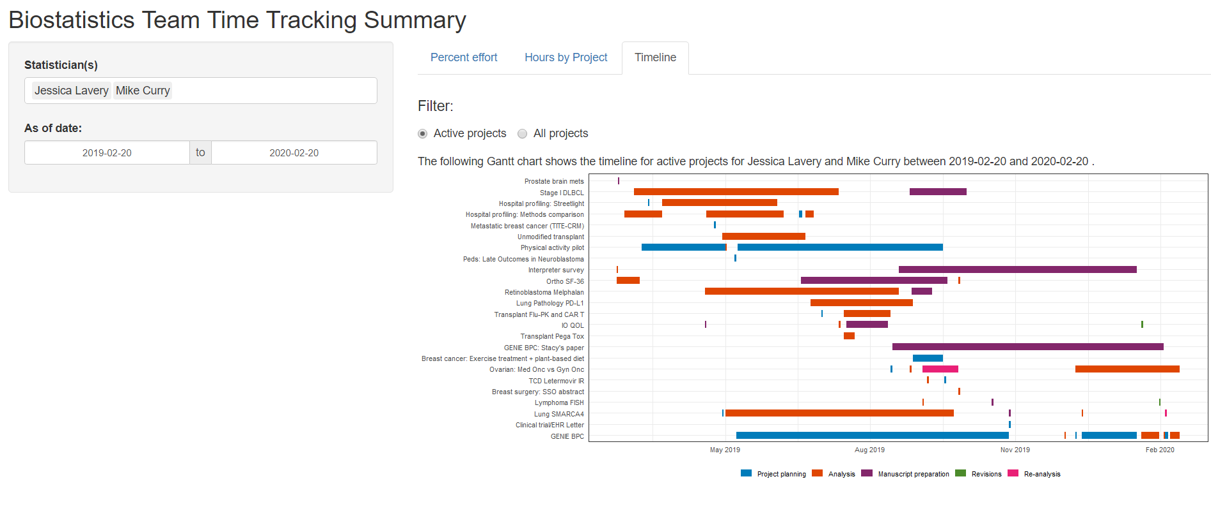

Slide 20
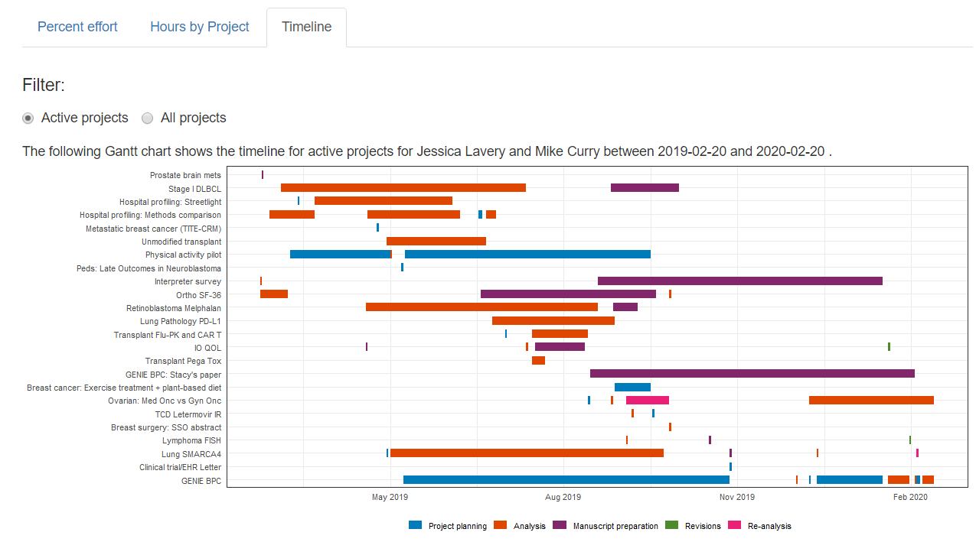

Slide 21
Information gleaned from timetrackR
In the last 3 months, >75% of my time has been devoted to a single project. Can we can bring someone else on to that project? (percent effort)
I spent more hours on a presentation for JSM than I thought I did. Maybe I should turn that into a manuscript? (total hours)
A particular project transitioned between analysis and re-analysis several times throughout the project’s life cycle. Is it time for a regroup with the investigator? (Gantt chart)

Slide 22
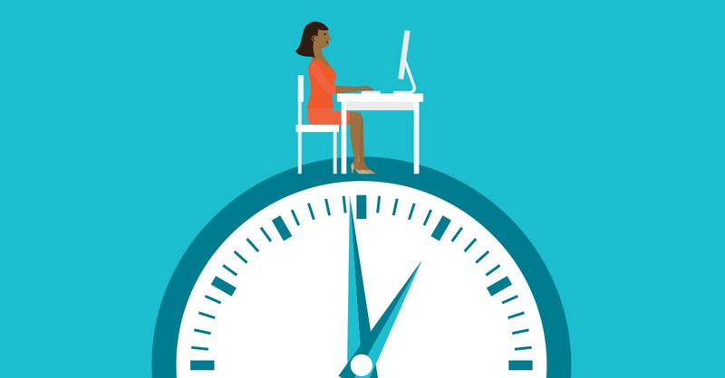
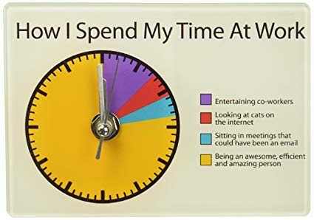
How timetrackR works
Track time
Analyze time

Slide 23
Workflow: Initial Setup
Fork the GitHub repo
Includes a template time tracker and template project tracker tab
Time tracker is where you log your hours
Project tracker summarizes information like principal investigator (PI), deliverable, status, etc.

Slide 24
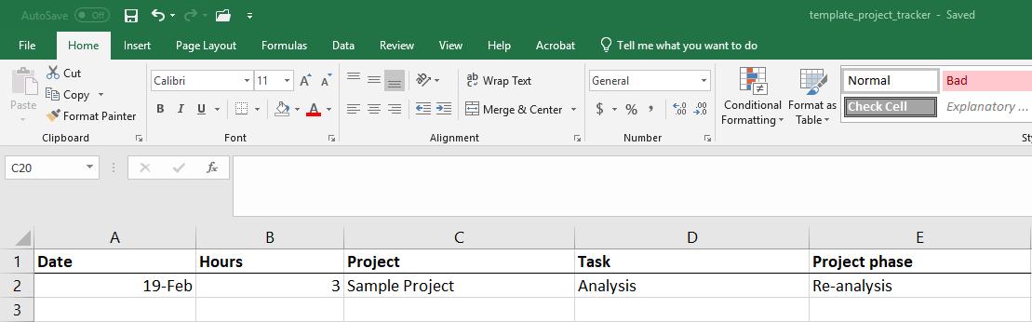

Template Time Tracker

Slide 25
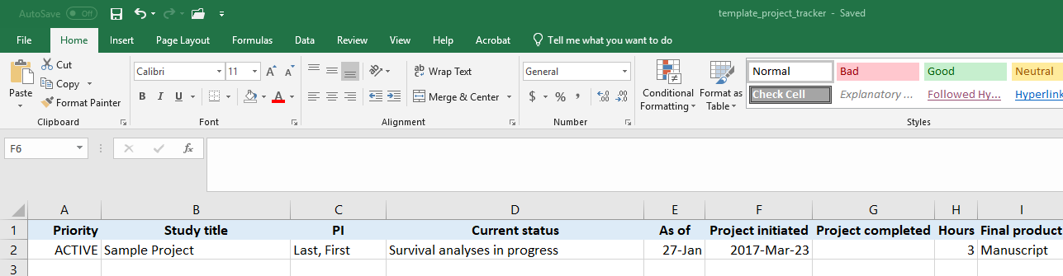

Template Project Tracker

Slide 26
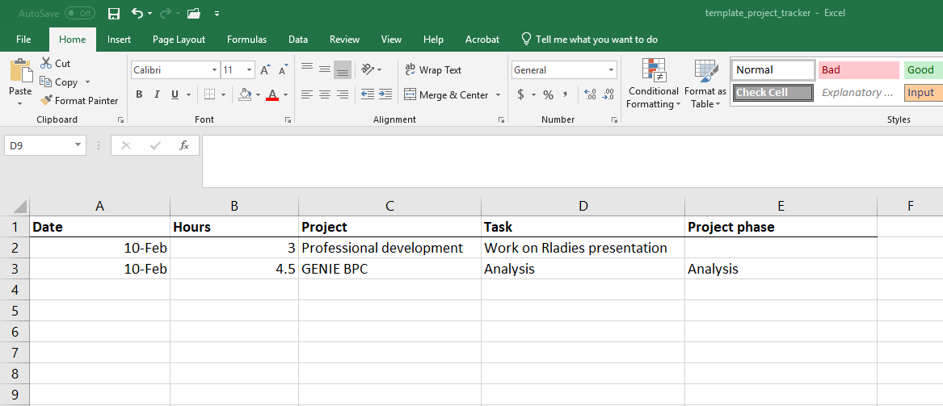
Workflow: Daily
Midday and/or end of day: Log your hours
Consistency is key so that projects are grouped appropriately

Slide 27
Workflow: Monthly? Quarterly?
Run the timetrackR app to summarize how you’ve been spending your time
Create data frames for shiny app
Summarize number of hours across projects
Concatenate data from multiple statisticians
Identify active vs inactive projects
Will need to edit this program the first time running the app
server: set of instructions to build the app
ui: defines a webpage that the user interacts with, it controls layout and appearance

Slide 28
R Code Highlights: The switch function and geom_segment()

Slide 29
Code tidbits: switch function
Used to update the figure depending on which input (statistician, date range, project status) is selected
To display the bar chart for active projects or for all projects:
Utilize radio button so that user can select active or all projects
Use the switch function to update the data frame depending on which is selected

Slide 30
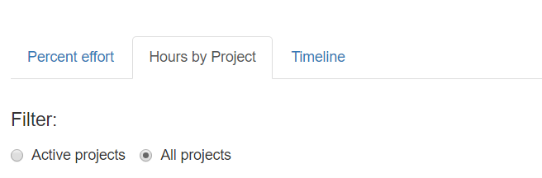
switch function: Bar chart application
App interface:
input$status_filter_bar returns either “Active projects” or “All projects” depending on which radio button is selected
Code (server.R):
Using switch function to subset the data on active projects if needed, otherwise proceeding with all projects
switch(input$status_filter_bar, "Active projects" = bar_filtered <- tracker %>% filter(status == "Active"), "All projects" = bar_filtered <- tracker)

Slide 31
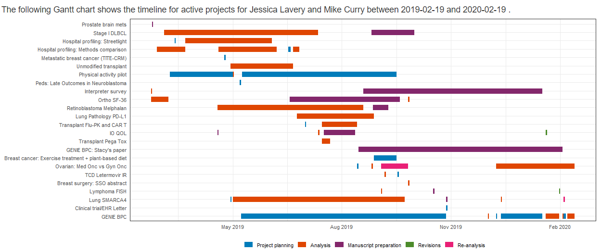
Code tidbits: Gantt Chart
Made using ggplot with geom_segment()

Slide 32
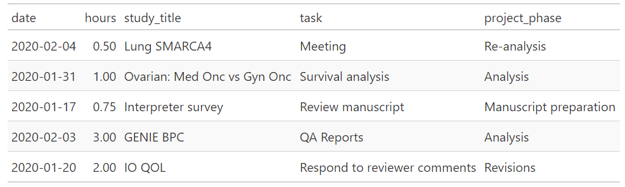
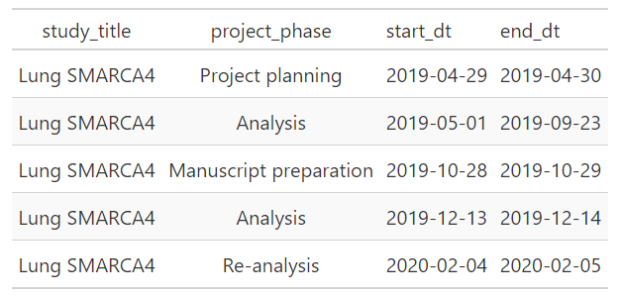
Gantt chart
Data wrangling: Summarize hourly data into project phase start / stop times

Slide 33
Gantt chart
Data viz: ggplot(phase_filtered) + geom_segment(aes(x = start_dt, xend = end_dt, y = study_title, yend = study_title, colour = project_phase), size = 4) + theme_bw() + scale_color_manual(values = mskRvis::msk_palette("contrast")) + theme(legend.position = "bottom", legend.title = element_blank(), axis.title = element_blank(), axis.ticks = element_blank()) + scale_x_date(breaks = "3 months", date_labels = "%b %Y")

Slide 34
Caveats
Be careful about your denominators! This is a count of what you recorded
Won’t tell you if you spent 2 hours on Twitter or 45 minutes replying to an email (unless you write that down yourself!)
Corollary: this is only useful if you track your time relatively accurately
Tracks by number of hours, not time of day
15 minute increments at a minimum, sometimes record a single project or activity for an entire day
Do what works best for you
Entirely retrospective: it’s a summary of what you’ve done, doesn’t include projected time allocations

Slide 35
Future Plans
Incorporate with Toggl app (or others) to automate a portion of the tracking
Automated time tracking + customizable reporting = best of both worlds?
Incorporate additional visualizations and/or summary measures
Changes over time?
Suggestions?

Slide 36
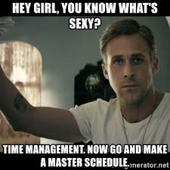
Summary
Very few metrics are needed to gain a general understanding of how you’re spending your time
Can be used to track time across a team or to look at your own time
Can be used to align (or re-align) with how you intend to spend your time

Slide 37




Thank you!
https://github.com/jalavery/proj_mgmnt
laveryj@mskcc.org
Special thanks to Margie Hannum & Karissa Whiting for sharing their creative naming skills to come up with the name of both the app and this talk.
Thanks also to Mike Curry for letting me share his time tracking data and his patience in answering my many R questions.
@jessicalavs
www.JessicaLavery.com

